Slide 1
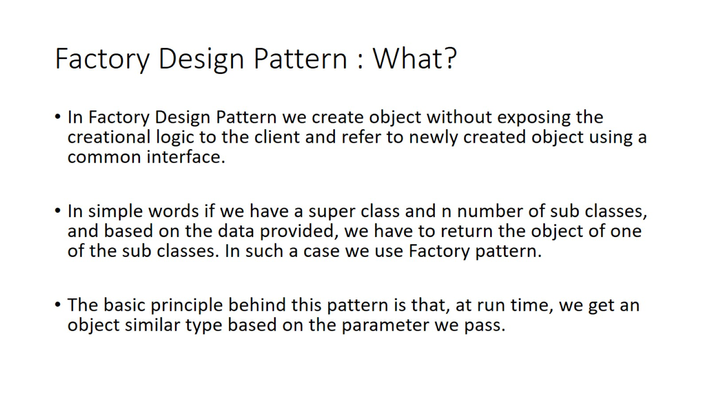
Factory Design Pattern : What?

Slide 2
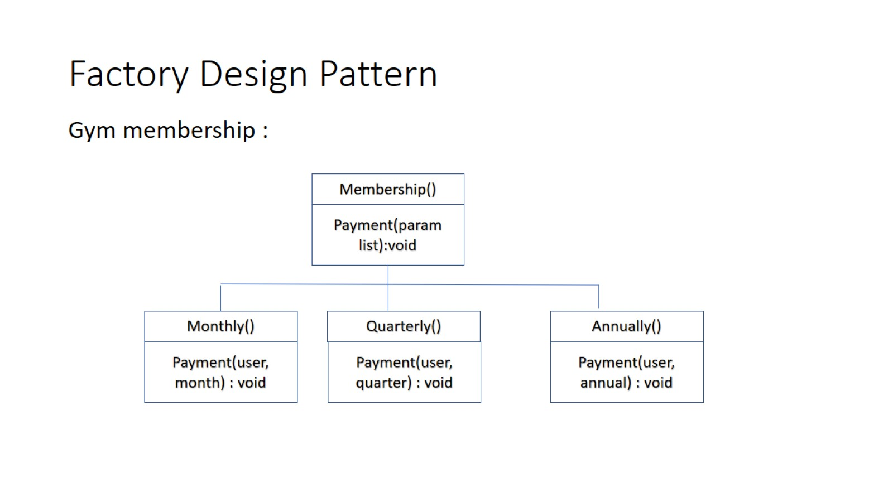
Factory Design Pattern

Slide 3
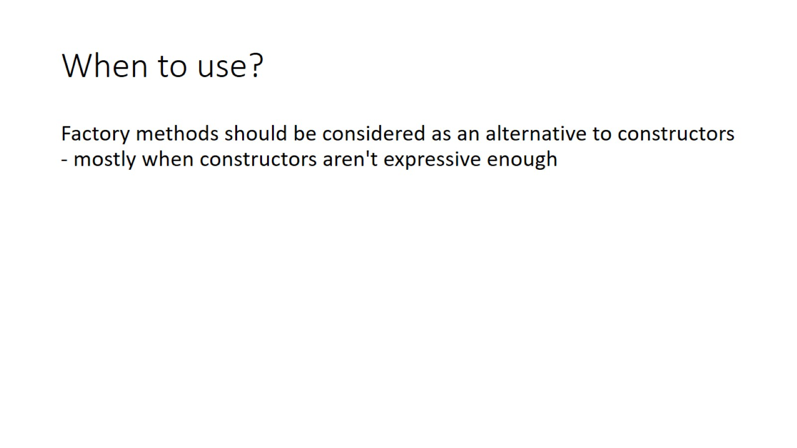
When to use?

Slide 4
Implementation in JDK
Java.util.Calendar # getInstance()
Java.util.ResourceBundle # getBundle()
Java.text.NumberFormat # getInstance()
Java.util.Enumset # of()

